Slide 1
Queues
© 2013 Goodrich, Tamassia, Goldwasser
Queues
Notes:
Queues

Slide 2
The Queue ADT
The Queue ADT stores arbitrary objects
Insertions and deletions follow the first-in first-out scheme
Insertions are at the rear of the queue and removals are at the front of the queue
Main queue operations:
  enqueue(object): inserts an element at the end of the queue
  object dequeue(): removes and returns the element at the front of the queue
Auxiliary queue operations:
  object first(): returns the element at the front without removing it
  integer len(): returns the number of elements stored
  boolean is_empty(): indicates whether no elements are stored
Exceptions
  Attempting the execution of dequeue or front on an empty queue throws an EmptyQueueException
© 2013 Goodrich, Tamassia, Goldwasser
Queues
Notes:
Queues

Slide 3
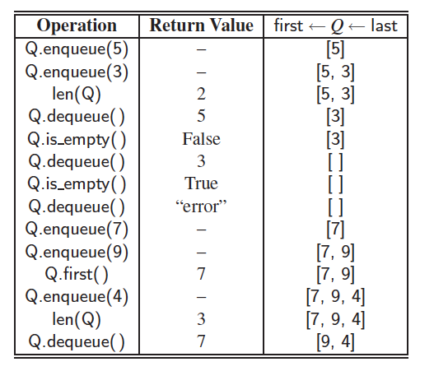
Example
© 2013 Goodrich, Tamassia, Goldwasser
Queues

Slide 4
Applications of Queues
Direct applications
  Waiting lists, bureaucracy
  Access to shared resources (e.g., printer)
  Multiprogramming
Indirect applications
  Auxiliary data structure for algorithms
  Component of other data structures
© 2013 Goodrich, Tamassia, Goldwasser
Queues

Slide 5
Array-based Queue
Use an array of size N in a circular fashion
Two variables keep track of the front and rear
  f index of the front element
  r index immediately past the rear element
Array location r is kept empty
normal configuration
Q
0
1
2
f
r
wrapped-around configuration
Q
0
1
2
r
f
© 2013 Goodrich, Tamassia, Goldwasser
Queues

Slide 6
Queue Operations
We use the modulo operator (remainder of division)
Algorithm size()
return (N − f + r) mod N
Algorithm isEmpty()
return (f = r)
Q
0
1
2
f
r
Q
0
1
2
r
f
© 2013 Goodrich, Tamassia, Goldwasser
Queues

Slide 7
Queue Operations (cont.)
Operation enqueue throws an exception if the array is full
This exception is implementation-dependent
Algorithm enqueue(o)
if size() = N − 1 then
throw FullQueueException
else
Q[r] ← o
r ← (r + 1) mod N
Q
0
1
2
f
r
Q
0
1
2
r
f
© 2013 Goodrich, Tamassia, Goldwasser
Queues

Slide 8
Queue Operations (cont.)
Operation dequeue throws an exception if the queue is empty
This exception is specified in the queue ADT
Algorithm dequeue()
if isEmpty() then
throw EmptyQueueException
else
o ← Q[f]
f ← (f + 1) mod N
return o
Q
0
1
2
f
r
Q
0
1
2
r
f
© 2013 Goodrich, Tamassia, Goldwasser
Queues

Slide 9
Queue in Python
Use the following three instance variables:
  _data: is a reference to a list instance with a fixed capacity.
  _size: is an integer representing the current number of elements stored in the queue (as opposed to the length of the data list).
  _front: is an integer that represents the index within data of the first element of the queue (assuming the queue is not empty).
© 2013 Goodrich, Tamassia, Goldwasser
Queues

Slide 10
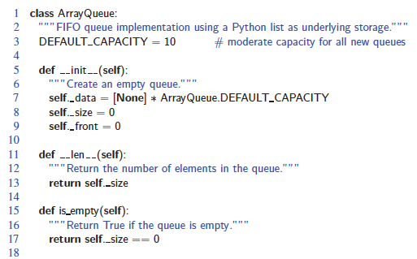
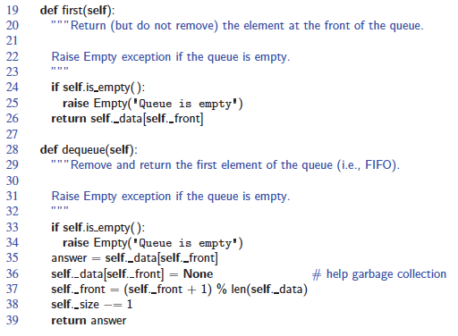
Queue in Python, Beginning
© 2013 Goodrich, Tamassia, Goldwasser
Queues

Slide 11
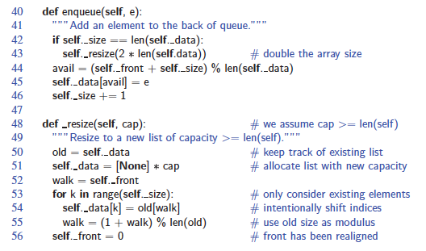
Queue in Python, Continued
© 2013 Goodrich, Tamassia, Goldwasser
Queues

Slide 12
Application: Round Robin Schedulers
We can implement a round robin scheduler using a queue Q by repeatedly performing the following steps:
  e = Q.dequeue()
  Service element e
  Q.enqueue(e)
Queue
Dequeue
Enqueue
Shared
Service
© 2013 Goodrich, Tamassia, Goldwasser
Queues

